Slide 1
STRATIFY SCHIZOPHRENIA PATIENTS BY CLUSTER ANALYSIS BASED ON STRUCTURAL MRI DATA

Slide 2
OUTLINE
Goal : Stratify Schizophrenia (SCZ) using structural MRI data on a multi-site population of 276 patients
Pipeline:
Decomposition of VBM features into 10 Principal Components
Correct PCs for effects of age, gender and site
Cluster Analysis using K-means algorithm on these 10 adjusted PCs
Characterize structural specificities of clusters
Assess neuropsychological performance and symptoms severity of clusters using 118 patients for which clinical data is available

Slide 3
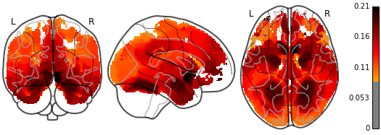
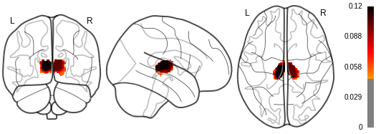
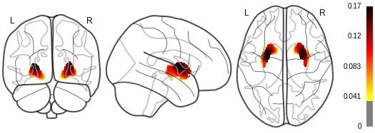
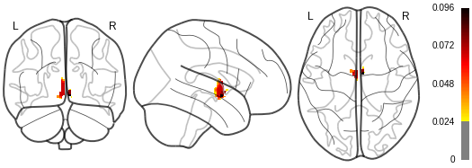
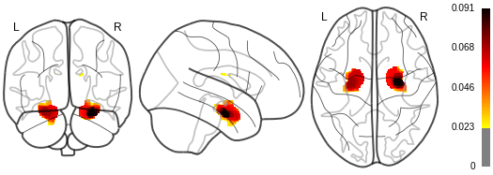
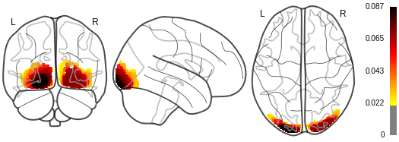
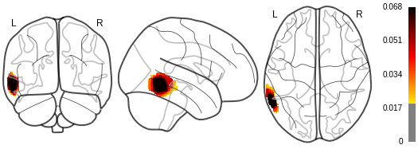
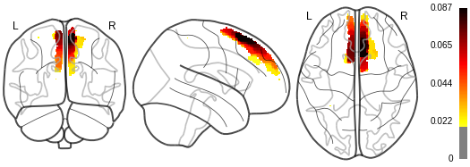
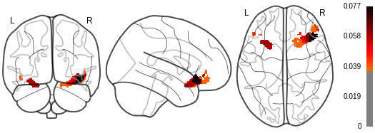
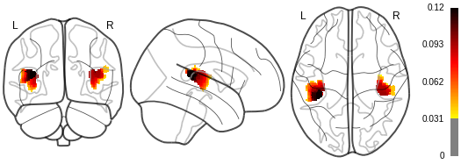
DECOMPOSITION OF VBM FEATURES INTO 10 PCs
Decomposition
Components weight maps
High dimensional input: 125,959 VBM features
Decomposition of VBM features into 10 interpretable Principal Components (PCs) using Structured Sparse Principal Components Analysis (SPCA-TV)
Low dimensional output: 10 scores associated to each PC weight map

Slide 4
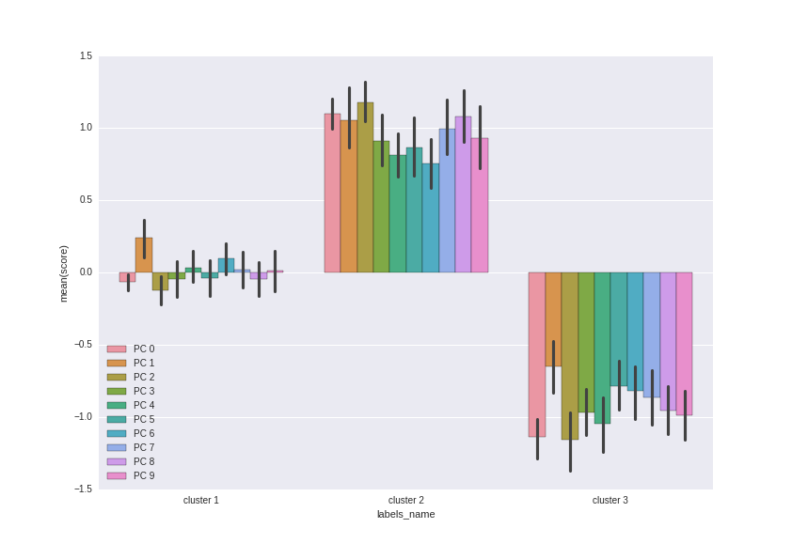
CLUSTER ANALYSIS: METHODS
Adjust the 10 scores for effects of age, gender and site
Clusterize using K-means algorithms based on the 10 adjusted scores
Example of the 3-clusters solution:
Cluster 1: Medium atrophy on all 10 PC
Cluster 2: Low atrophy on all 10 PC
Cluster 3: High atrophy on all 10 PC

Slide 5
CLUSTER ANALYSIS: Structural specificities of clusters
Clusters are created according to the amount of global atrophy:
Cluster 1: Medium atrophy on all 10 PC
Cluster 2: Low atrophy on all 10 PC
Cluster 3: High atrophy on all 10 PC
PC | Cluster 1 (mean) | Cluster 2 (mean) | Cluster 3 (mean) | F | p
1 - Global Atrophy | -0.07 | 1.01 | -1.14 | 447.1 | 7e⁻⁸⁷
2 - Putamen/Caudate | 0.24 | 1.05 | -0.65 | 79.7 | 5.2e⁻²⁸
3 - Hippocampus/Amygdala | -0.12 | 1.17 | -1.16 | 206.5 | 2.3e⁻⁵⁵
4 - Temporal Gyrus | -0.04 | 0.90 | -0.96 | 125.3 | 2.4e⁻³⁹
5 - Frontal Orbital Cortex | 0.03 | 0.81 | -1.04 | 131.8 | 8.5e⁻⁴¹
6 - Thalamus | -0.04 | 0.86 | -0.78 | 82.01 | 1.28e⁻²⁸
7 - Left Thalamus | 0.09 | 0.75 | -0.81 | 85.1 | 1.84e⁻²⁹
8 - Occipital | 0.02 | 0.99 | -0.86 | 105.6 | 1.0e⁻³⁴
9 - Superior Frontal Gyrus | -0.04 | 1.07 | -0.95 | 140.4 | 1.1e⁻⁴²
10 - Heschl’s gyrus | 0.01 | 0.93 | -0.99 | 99.6 | 3.2e⁻³³

Slide 6
CLUSTER ANALYSIS: Structural specificities of clusters
No demographic differences between patients of clusters:
Variables | Cluster 1 | Cluster 2 | Cluster 3
Sex (M/F) | 93/40 | 56/14 | 51/22
Age(years) | 35.52 ± 12.1 | 32.85 ± 12.6 | 34.06 ± 10.8
Site (1/2/3/4) | 37/22/50/24 | 24/12/27/7 | 16/8/41/8

Slide 7
CLUSTER ANALYSIS: SPECIFICITIES
Goal : To determine the relationship between clustering results and cognitive performance.
Methods: We examined the clustering results obtained in relation to performance on a battery of neuropsychological tests administered to 118 of the 276 participants:
Verbal Learning
Working memory
Processing speed
Attention
Intellectual functioning
We also examined the clustering results obtained in relation to symptom severity assessed with the SAPS-SANS scale.
SAPS score
SANS score

Slide 8
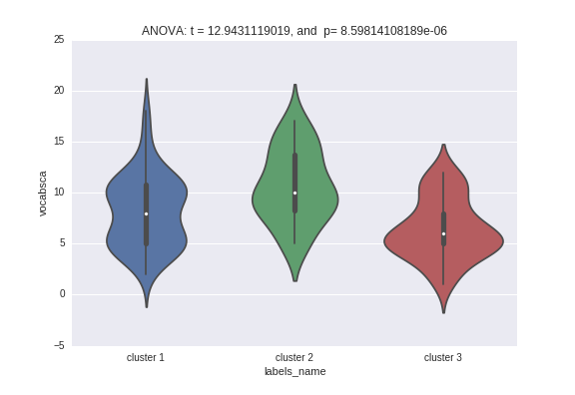
CLUSTER ANALYSIS: Vocabulary test
WAIS vocabulary score: Most atrophied patients perform badly, while most preserved patients usually perform better
Reminder:
Cluster 1: Medium atrophy
Cluster 2: Low atrophy
Cluster 3: High atrophy
Test | Cluster 1 (mean ± SD) | Cluster 2 (mean ± SD) | Cluster 3 (mean ± SD) | F | p
WAIS vocabulary score | 8.16 ± 3.4 | 10.6 ± 3.4 | 6.39 ± 2.8 | 12.94 | 8e⁻⁶

Slide 9
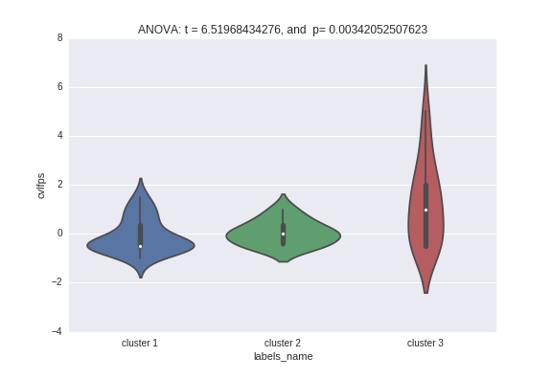
CLUSTER ANALYSIS: Verbal learning
CVLT Total false positive (Verbal learning) : Most atrophied patients (Cluster 3) do more errors than other groups
Reminder:
Cluster 1: Medium atrophy
Cluster 2: Low atrophy
Cluster 3: High atrophy
Test | Cluster 1 (mean ± SD) | Cluster 2 (mean ± SD) | Cluster 3 (mean ± SD) | F | p
CVLT Total false positive errors | -0.08 ± 0.7 | 0.05 ± 0.4 | 1.23 ± 1.6 | 6.51 | 3.4e⁻³

Slide 10
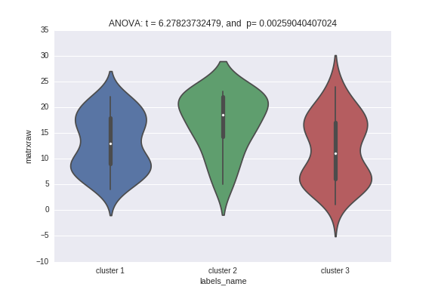
CLUSTER ANALYSIS: Reasoning skills
WAIS Matrix reasoning score (non verbal reasoning skills) : More preserved patients performed better than other groups.
Reminder:
Cluster 1: Medium atrophy
Cluster 2: Low atrophy
Cluster 3: High atrophy
Test | Cluster 1 (mean ± SD) | Cluster 2 (mean ± SD) | Cluster 3 (mean ± SD) | F | p
Matrix Reasoning score | 13.02 ± 5.4 | 16.9 ± 5.6 | 11.8 ± 6.4 | 6.27 | 2.5e⁻³

Slide 11
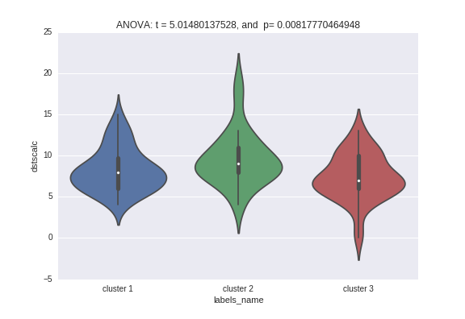
CLUSTER ANALYSIS: Working memory
Digit span total score (Working memory) : More preserved patients performed better than other groups
Reminder:
Cluster 1: Medium atrophy
Cluster 2: Low atrophy
Cluster 3: High atrophy
Test | Cluster 1 (mean ± SD) | Cluster 2 (mean ± SD) | Cluster 3 (mean ± SD) | F | p
Digit span total score | 8.26 ± 2.6 | 9.61 ± 3.2 | 7.36 ± 2.7 | 5.01 | 8.0e⁻³

Slide 12
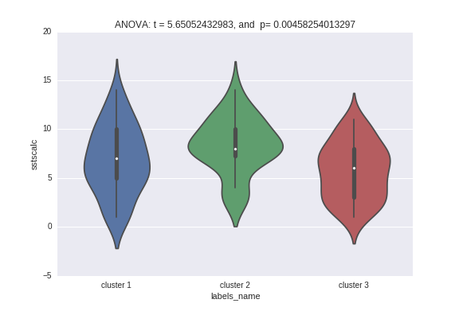
CLUSTER ANALYSIS: Working memory
Spatial span total score (Working memory) : More preserved patients performed better than other groups
Reminder:
Cluster 1: Medium atrophy
Cluster 2: Low atrophy
Cluster 3: High atrophy
Test | Cluster 1 (mean ± SD) | Cluster 2 (mean ± SD) | Cluster 3 (mean ± SD) | F | p
Spatial span total score | 6.81 ± 3.4 | 8.30 ± 2.8 | 5.68 ± 2.8 | 5.65 | 4.5e⁻³

Slide 13
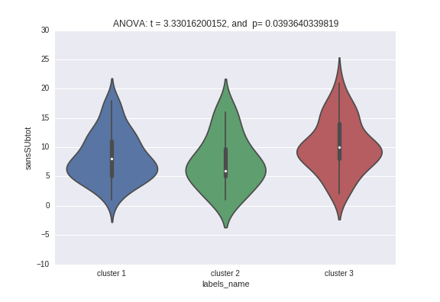
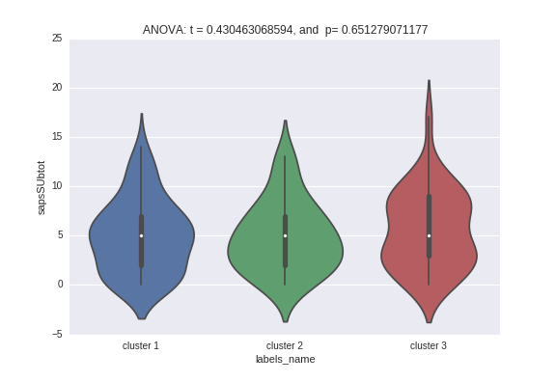
CLUSTER ANALYSIS: Symptoms
SANS: More atrophied patients have a trend toward higher SANS score (p=0.03)
SAPS: No significant differences between SAPS score of the 3 clusters
Symptoms scores | Cluster 1 (mean ± SD) | Cluster 2 (mean ± SD) | Cluster 3 (mean ± SD) | F | p
SAPS | 4.94 ± 3.4 | 4.88 ± 2.8 | 5.60 ± 3.9 | 0.43 | 0.65
SANS | 8.36 ± 3.7 | 7.53 ± 3.5 | 10.17 ± 3.9 | 3.33 | 0.03

Slide 14
OUTLINE
Summary: SCZ patients have been stratified into subgroups of varying severity using structural MRI data. The clusters differ in terms of neuropsychological test performances and symptoms.
Ideas
Select PCs that are known to be involved in SCZ disease instead of taking the first 10 PC to run the clustering algorithm
Procedure to select the optimum number of clusters
Normalize the PC scores by global brain atrophy, to cluster patients according to the relative involvement of each region rather than global atrophy. (= Stratify into subgroup of SCZ disease, instead of severity level)
...

